Slide 1
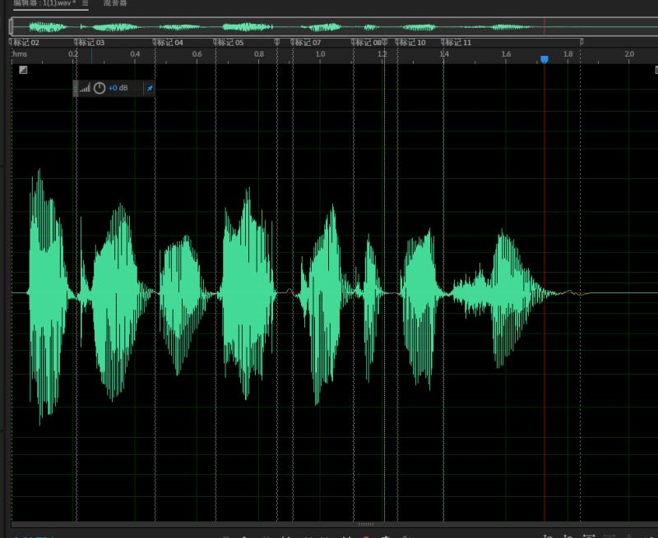
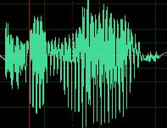
手工切割间隔
能量小不代表没声音
单词之间可能就没有间隔而且无法切分
to make
O K Goo Gle Ta ke Pic ture

Slide 2
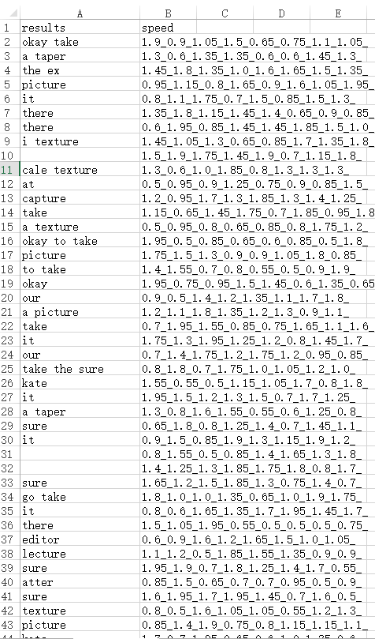

手工切割后倍速结果
可听性收到影响
1
2
14

Slide 3
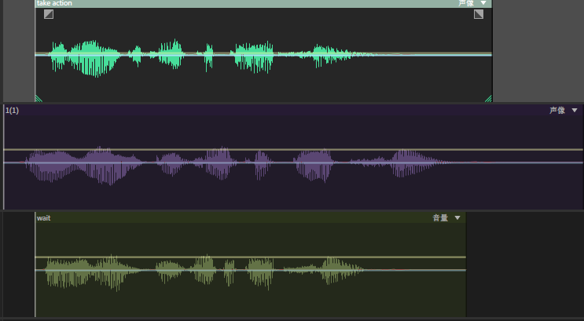
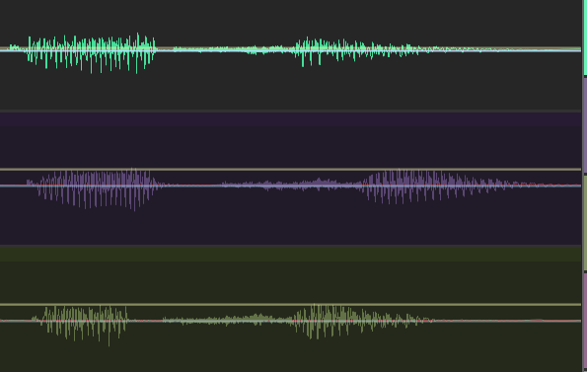
TSM——AU对比图
时间变短
毛刺变多
能量变小
I want to take a picture/Take action/Wait

Slide 4
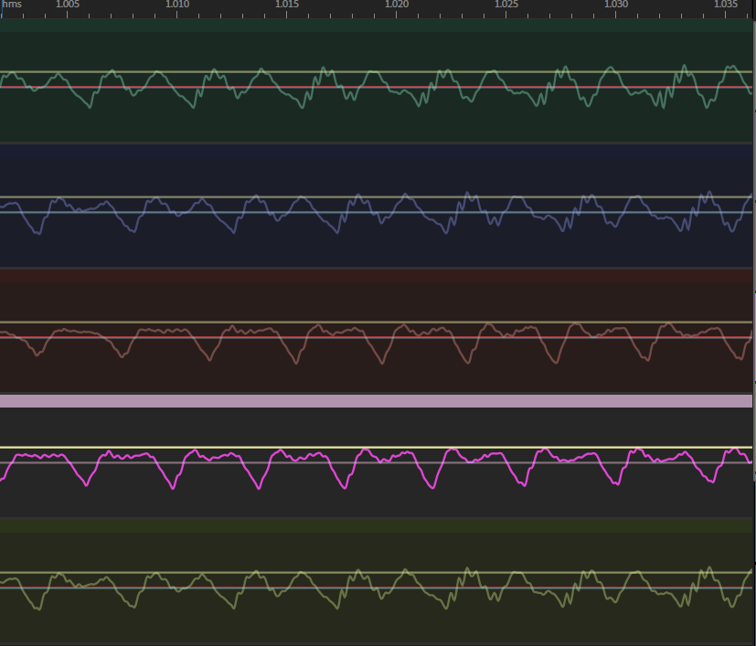
TSM——1倍速不同算法AU对比图
I want to take a picture
ffmpeg/ola/pv/wsola/origin
尖峰细节
平滑度

Slide 5
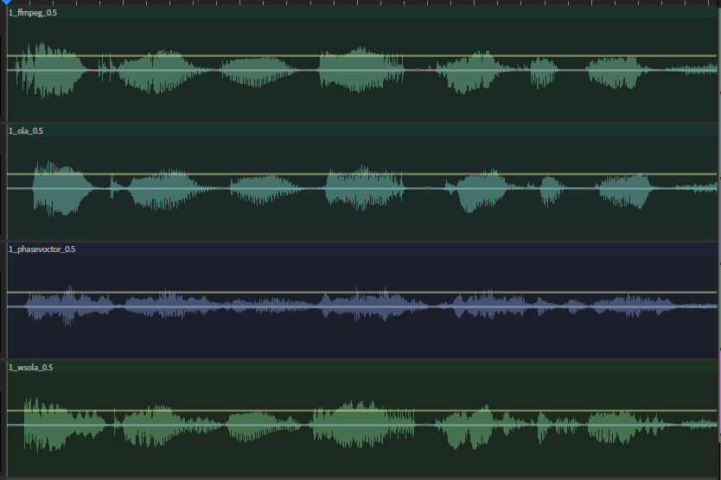
TSM——0.5整体倍速AU分析
FFmpeg：okay google takes a picture
OLA：okay gurgle tapiser
WSOLA：okay google taint the big ex
PV：空
慢放之后Ffmpeg波形收敛特性更好（震荡少）
PV波形细节损失很大

Slide 6
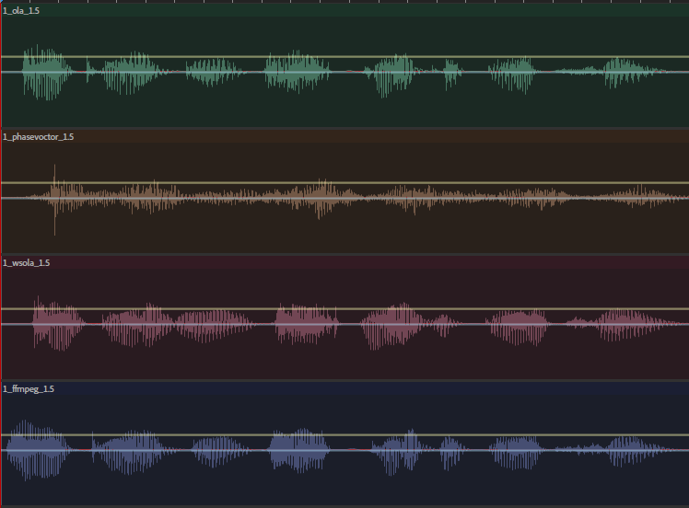
TSM——1.5整体倍速AU分析
FFmpeg：go take a picture
OLA：take a picture
WSOLA：okay google epicure
PV：空
可听性上ffmpeg和wsola连贯性更好
WSOLA在空隙处会平滑使得部分音素其实延长
OLA更多的毛刺

Slide 7
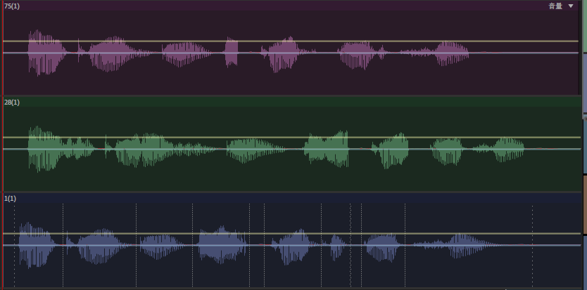
TSM——WSOLA细节观察
Frame中空隙平滑明显
Take a合并

Slide 8
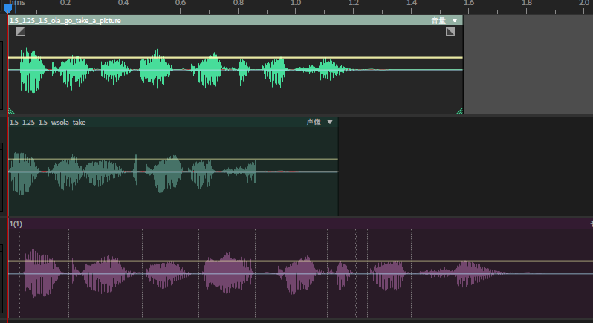
TSM——OLA与WSOLA的AU结果对比
I want to take a picture
1.5 1.25 1.5
OLA: go take a picture
WSOLA：take
【OLA】有噪声但是关键部分还在
【WSOLA】虽然听上去平滑但是少内容

Slide 9
TSM——WSOLA中基于VAD间隔速度变化对照实验
I want to take a picture
WSOLA
2_1_0.5
I’ll take the ex
1_1.25_1.5
1_1.25_2
1_1.5_2
2_1.5_1
Okay google take extra
Okay google take
Okay google take
at

Slide 10
TSM——OLA中基于VAD间隔速度变化对照实验
I want to take a picture
WSOLA
2_1_0.5
Take it sir
1_1.25_1.5
1_1.25_2
1_1.5_2
2_1.5_1
Okay google take a picture
Okay google take a picture
Okay google take a picture
Take a picture

Slide 11
TSM——OLA中基于50ms间隔速度变化对照实验
I want to take a picture
OLA
噪声和切片粒度有关
1.5:-0.01:1.5-36*0.01
1.5:-0.02:1.5-36*0.02
it
Take a picture
0.5:0.01:0.5+36*0.01
0.5:0.02:0.5+36*0.02
0.5:0.03:0.5+36*0.03
I want to take a picture
I want to take a picture
I want to take a picture

Slide 12
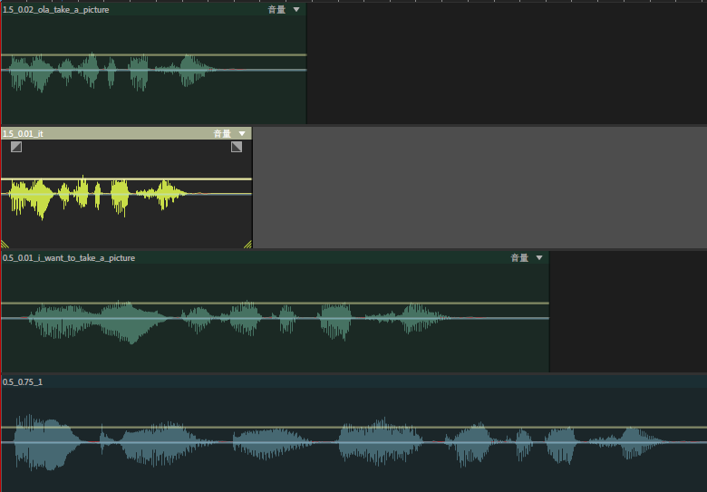
TSM——OLA中基于50ms间隔速度变化对照实验
I want to take a picture
OLA

Slide 13
TSM——WSOLA中基于50ms间隔速度变化对照实验
I want to take a picture
WSOLA
0.5
0.75-1
I want to take a picture
I want it
0.5:0.01:0.5+36*0.01
0.5:0.02:0.5+36*0.02
0.5:0.03:0.5+36*0.03
I want to take a picture
I wanted get picture
I wanted

Slide 14
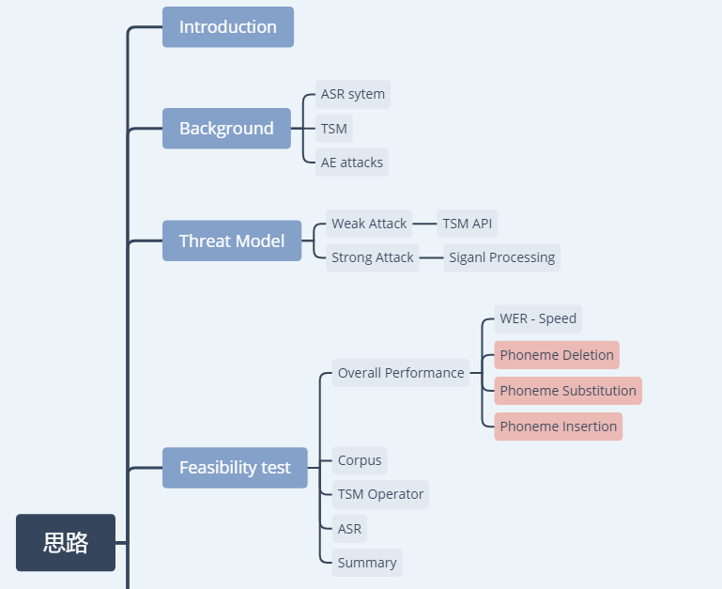
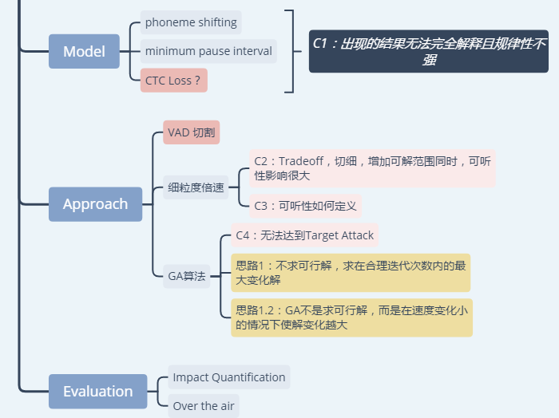
思路
xxx

Slide 15
思路
Image Scaling Attack: 不确定target情况下求最大差异图片
求最大差异解

Slide 16
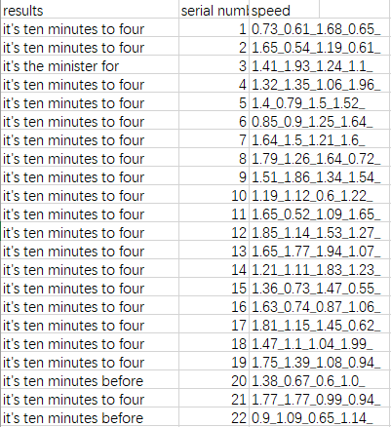
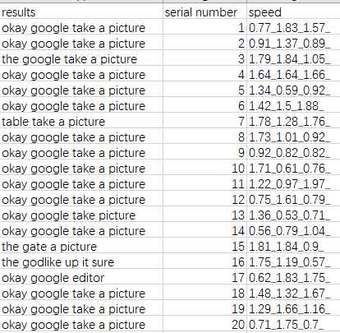
Ffmpeg对VAD frame识别结果为空更正
错误原因：音频数据格式错误
倍速后识别效果非常好
1.79_1.84_1.05
1.41_1.93_1.24_1.1
the google take a picture
it's the minister for
1.75_1.19_0.57
1.38_0.67_0.6_1.0
the godlike up it sure
it's ten minutes before

Slide 17
快速阈值探究
对音频进行TSM处理后，不会出现速度达到一个阈值后，识别结果全部都一样的情况，即识别结果与tsm速度之间的关系不是单调的。
对于音频OK Google, take a picture, VAD后有三段音频，对音频进行1.4_1.05_1.1倍速的结果为they take it
1
2
3

Slide 18
快速阈值探究
对第一段音频倍速速度从1.40开始按照0.01步长增加100次，其余音频速度不变出现they take dire、the lake dick、the leader、okay google take dick、take it、you take it、in letter、okay we‘ll take picture、i will take doctor等结果。改变每一段音频的速度，不仅会影响该段的识别结果，还会影响相邻和不相邻片段的识别结果。
1.4_1.05_1.1
1.41_1.05_1.1
1.42_1.05_1.1
1.45_1.05_1.1
1.51_1.05_1.1_
1.85_1.05_1.1
they take it
they take dire
the lake dick
okay google take dick
okay we'll take picture
they take it

Slide 19
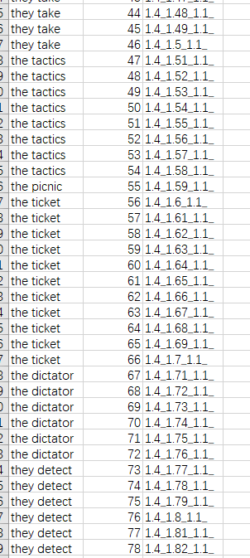
快速阈值探究
对第二段音频倍速速度从1.05开始按照0.01步长增加100次，其余音频速度不变出现they take、the technics、they take、the tanks、the tactics、the picnic、the ticket、the dictator、the pater等结果。呈现一定的规律性，即某一结果大致会在一定的速度区间内出现。
1.4_1.07_1.1
1.4_1.41_1.1
1.4_1.46_1.1
1.4_1.47_1.1
1.4_1.58_1.1
1.4_1.59_1.1
1.4_1.6_1.1
they take
the technics
the tanks
they take
the tactics
the picnic
the ticket

Slide 20
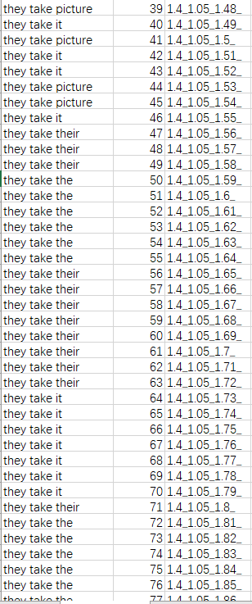
快速阈值探究
对第三段音频倍速速度从1.10开始按照0.01步长增加100次，其余音频速度不变出现they take tincture、they take this、they take picture、they take it、they take their、they take the等结果。改变第三段，只影响第三段的识别结果，且呈现一定的规律性，即某一结果大致会在一定的速度区间内出现。在1.81后识别结果均为they take the
1.4_1.05_1.11
1.4_1.05_1.13
1.4_1.05_1.18
1.4_1.05_1.29
1.4_1.05_1.4
1.4_1.05_1.59
they take tincture
they take picture
they take it
they take this
they take their
they take the

Slide 21
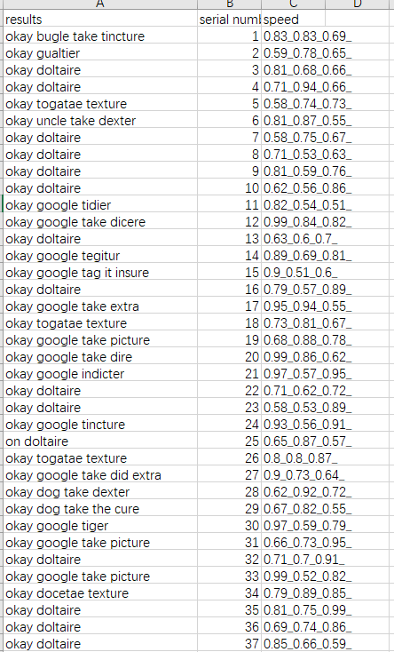
慢速增音探究
慢速不一定有增音，也有可能消音
是否有增音和原单词有关
0.81_0.75_0.99
0.9_0.51_0.6
okay doltaire
okay google tag it insure
0.92_0.53_0.63
0.94_0.74_0.52
okay google take it dick extra
okay google take big extra

Slide 22
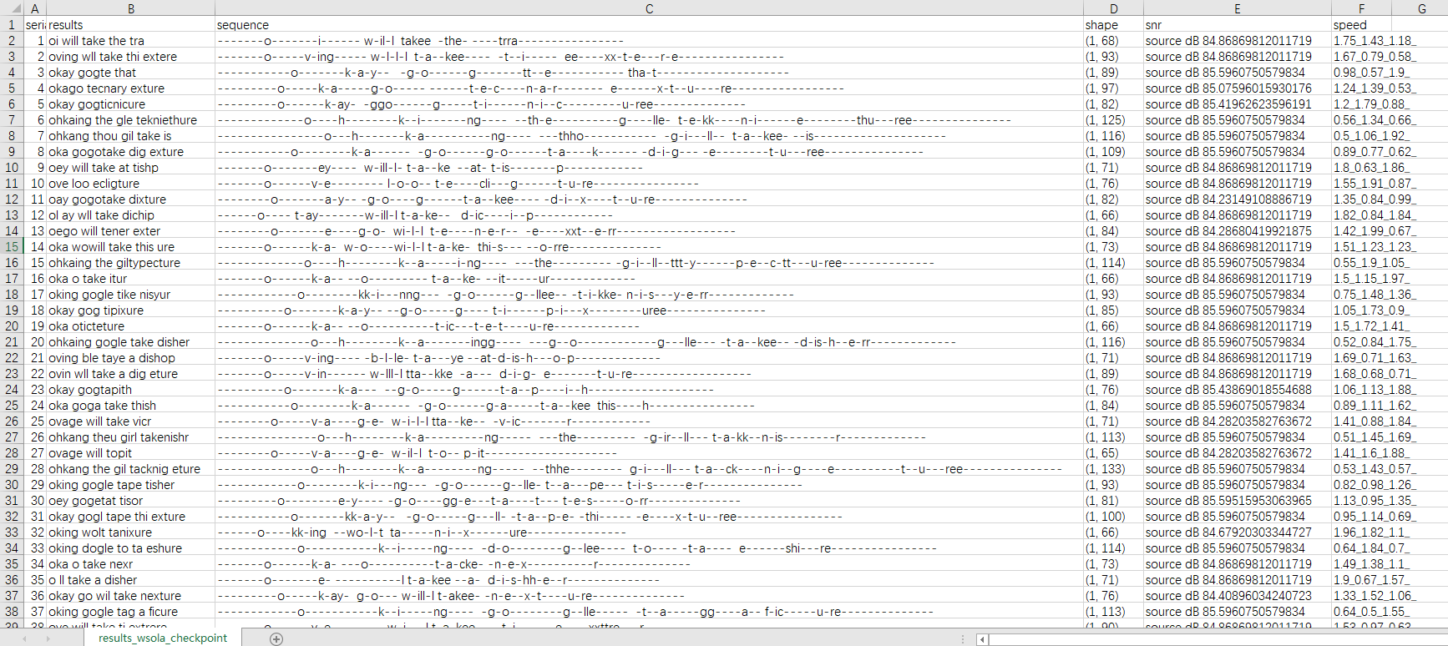
Deepspeech v0.4.1
1.75_1.43_1.18
1.9_0.67_1.57
1.41_1.6_1.88
0.4.1识别效果很差OK Google take a picture
oi will take the tra
o ll take a disher
ovage will topit

Slide 23
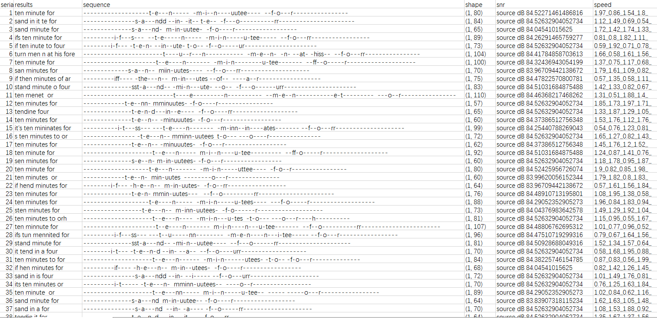
Deepspeech v0.4.1
1.66_0.58_1.61_1.56
0.53_0.6_0.5_1.29
1.33_1.87_1.29_1.05
0.4.1识别效果很差It’s ten minutes to four
turn men n at his fore
it's turne menet at the or
tendine four

Slide 24
Deletion 序列研究
1.75_1.43_1.18
1.9_0.67_1.57
1.41_1.6_1.88
OK Google，take a picture (1,106)
---------o--------k-ay-- -g-o--o---gg--lee----- t-a--kee --a-- -p-i-c-ttt---u-rre--------------------
oi will take the tra (1,68)
-------o-------i------ w-il-l takee -the- ----trra----------------
o ll take a disher (1,71)
-------o-------e- ----------l t-a-kee --a- d-i-s-hh-e--r--------------
ovage will topit (1,65)
--------o-----v-a----g-e- w-il-l t-o-- p-it--------------------
oi will take the tra
o ll take a disher
ovage will topit

Slide 25
Deletion 序列研究
1.66_0.58_1.61_1.56
0.53_0.6_0.5_1.29
1.33_1.87_1.29_1.05
It’s ten minutes to four (1,105)
-----------i-t-'-ss--- --t-e----n---- m-i-n----uuteess- t-o------- ---f--o----rr---------------------
turn men n at his fore (1,104)
-----------------------t----u--r---n----------- -m-e--n- -n- --at- -hiss-- --f-o---rr----------------
it's turne menet at the or(1,108)
----------i-t---ss---- ---t---u-rr---n---------- -m-e---n-------et- -at-- the--- ----o----r---------------
tendine four(1,65)
--------------t-e-n-d---in--e---- -f--o----rr-------------------
turn men n at his fore
it's turne menet at the or
tendine four

